Slide 1
FourOneSix Sound
Prepared by Romario Kevin Tulloch & Andrew Le

Slide 2
Sensor – TPA2016D2
Part Number: 1712 (Adafruit)
Amplifier Class: Class D Efficiency (~90% Efficiency)
Power Stats: 2.8W Peak Stereo
Voltage: 2.7V – 5.5V

Slide 3
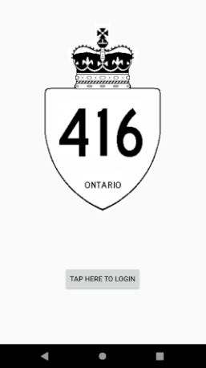
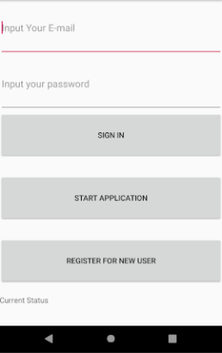
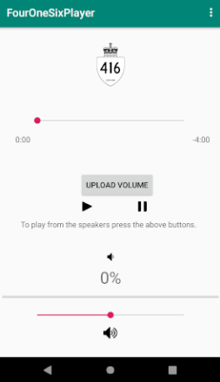
Android Application

Slide 4
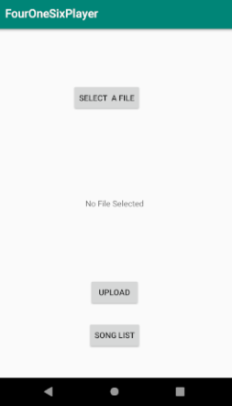
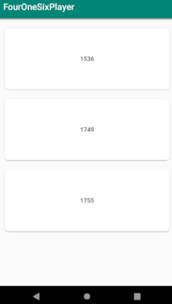
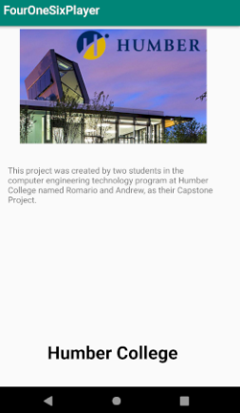
Android Application

Slide 5
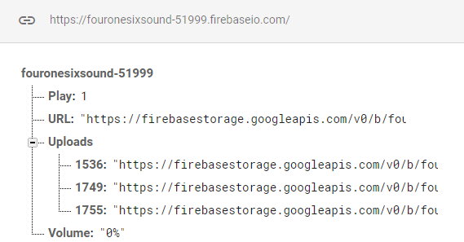
Firebase Database

Slide 6
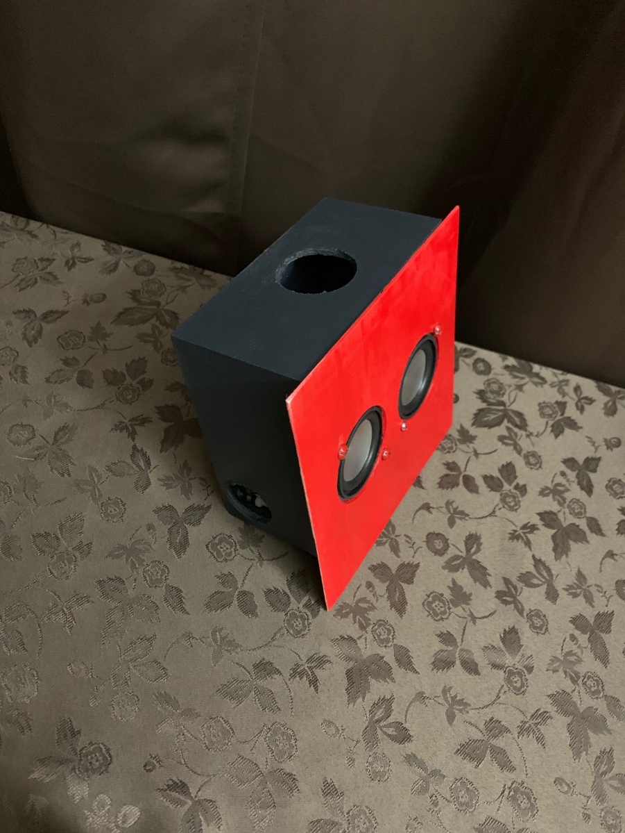
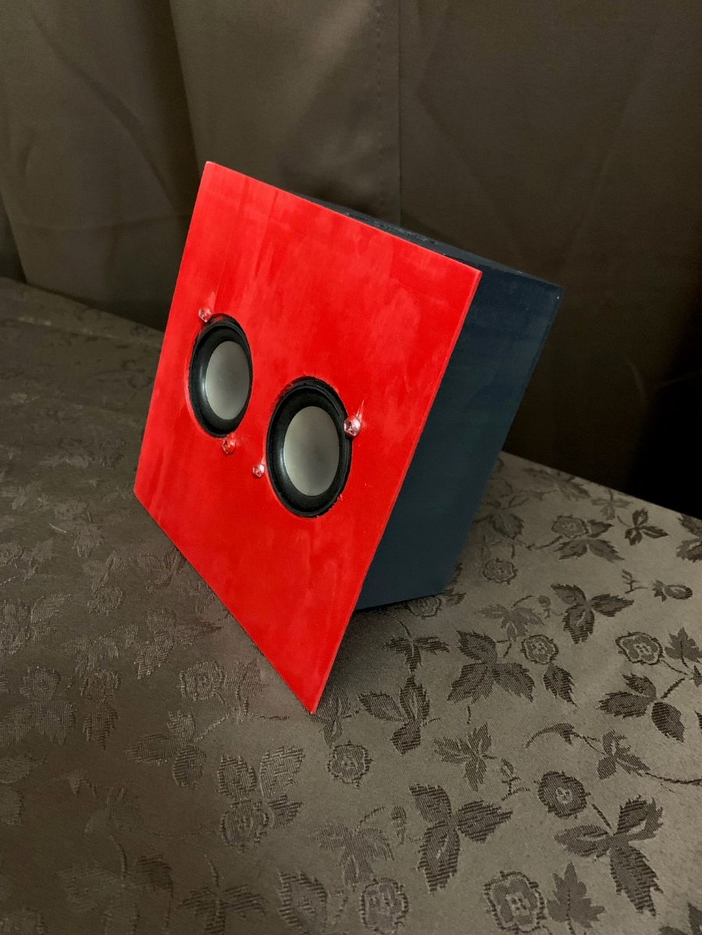
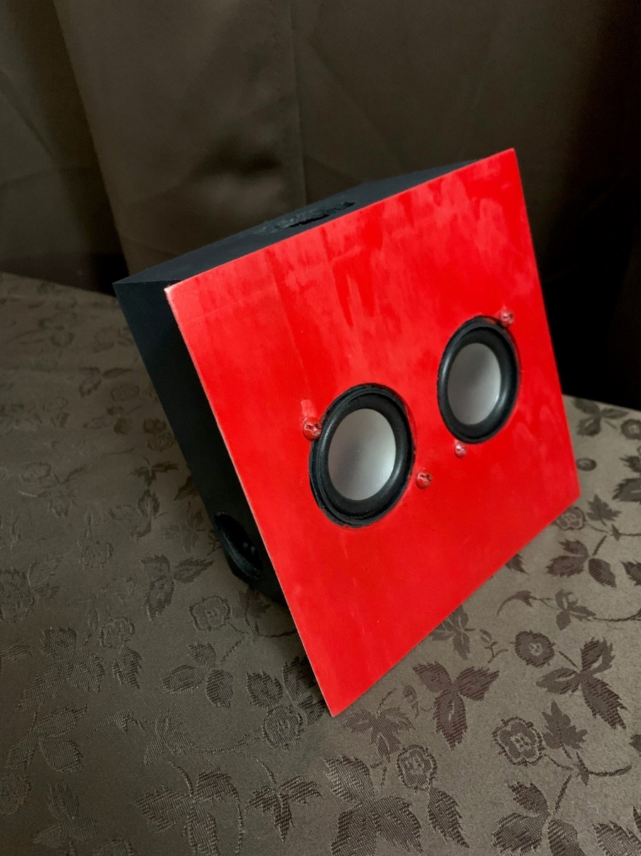
Final Setup

Slide 7
EXPO EXPERIENCE
Was a great experience having the opportunity to talk to market specialists.
Constructive criticism – both good and bad.
Seeing other projects.

Slide 8
Demo
Demonstrated the concept of the app
Explained connection between app and hardware
Answered questions in regards to the application of the project and why it defers from in market products.

Slide 9
GitHub Link
https://github.com/RomarioT/CENG355

